Slide 1
The Rocky Road app
An app and website interaction with users and organizers of the Rock the Earth organization.

Slide 2

User’s application
Features:
Scroll through current campaigns.
Upload supporter’s photo.
Share campaign on social media
Sign up for petitions.

Slide 3
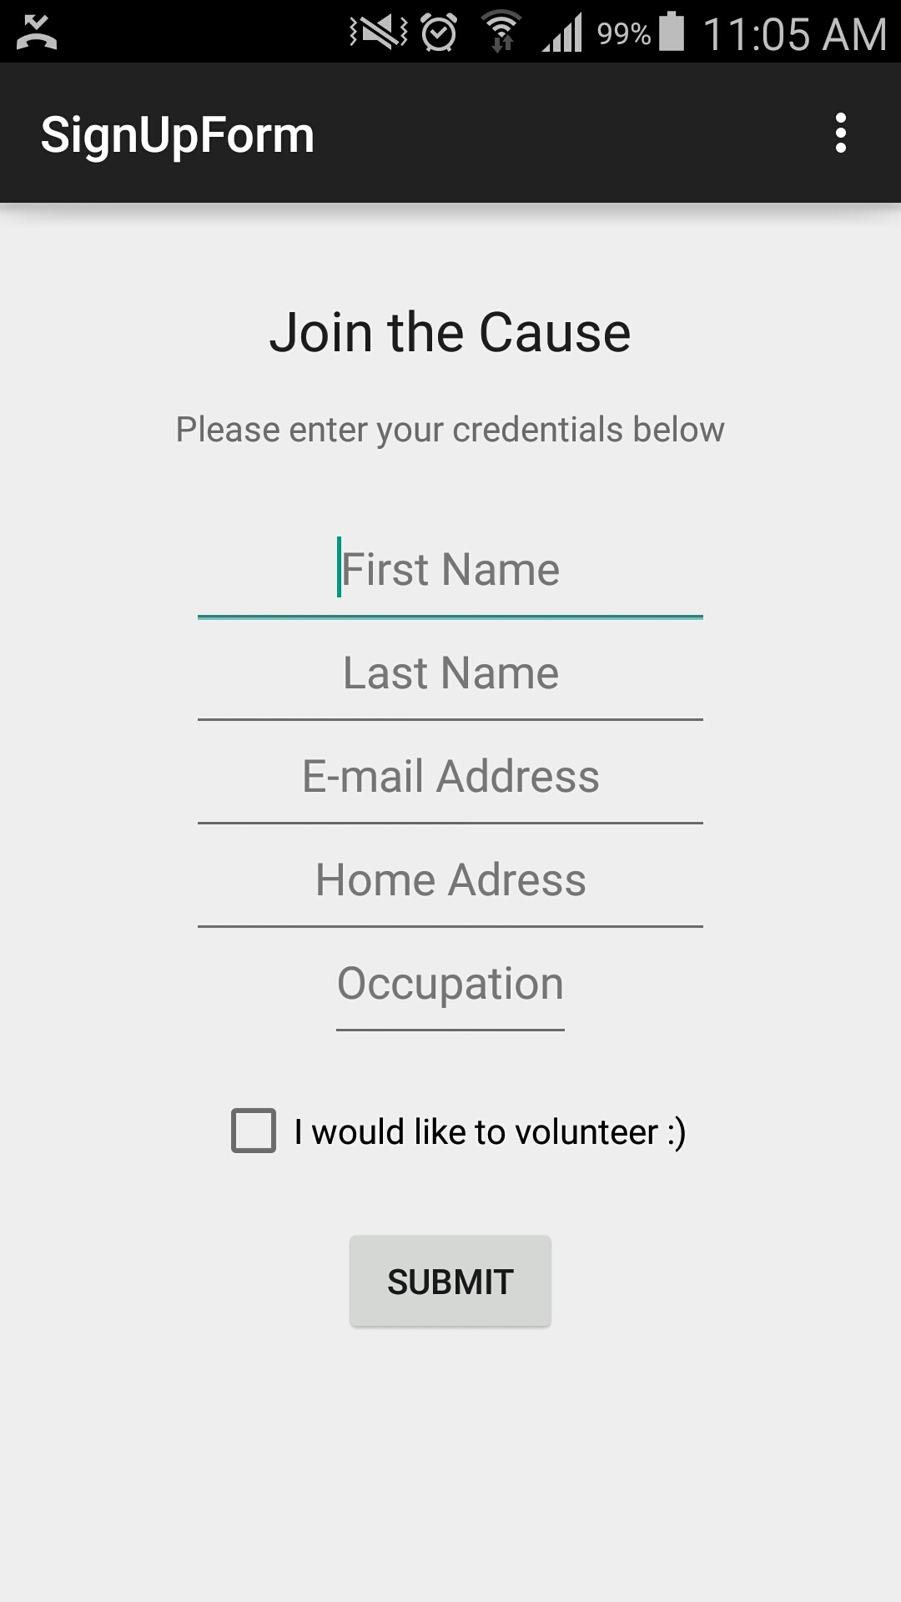
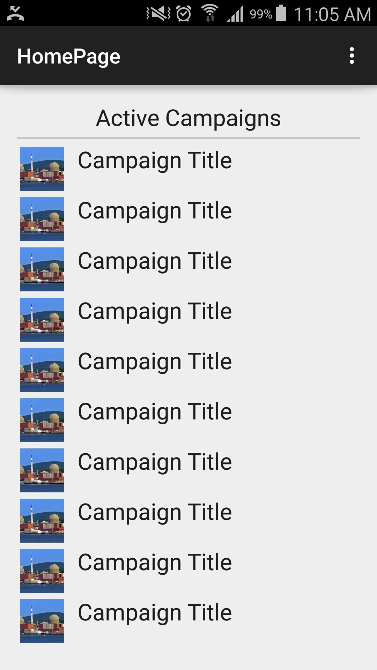
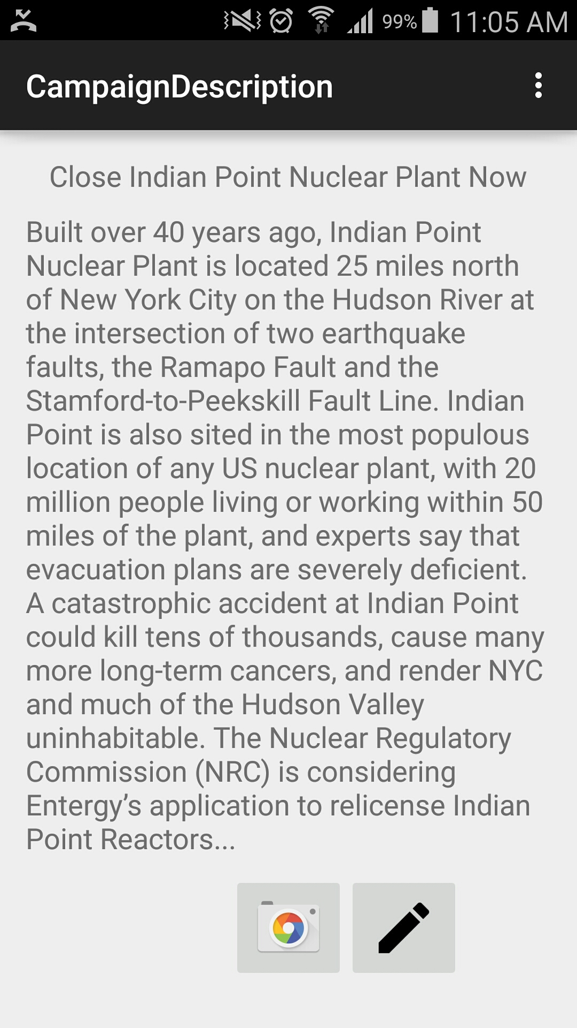
Screenshot of App

Slide 4
Organizer’s website
Features:
Statistics of current supporters in each campaign and current volunteers.
Staff are able to add new campaigns.
Listing of current campaigns and info.

Slide 5
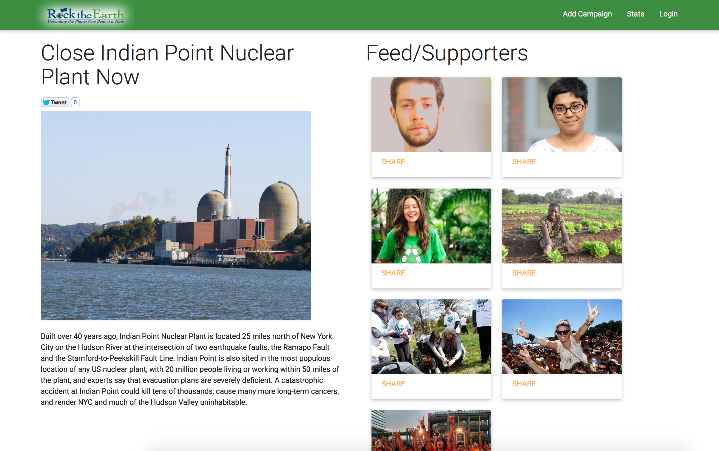
Screenshot of website

Slide 6
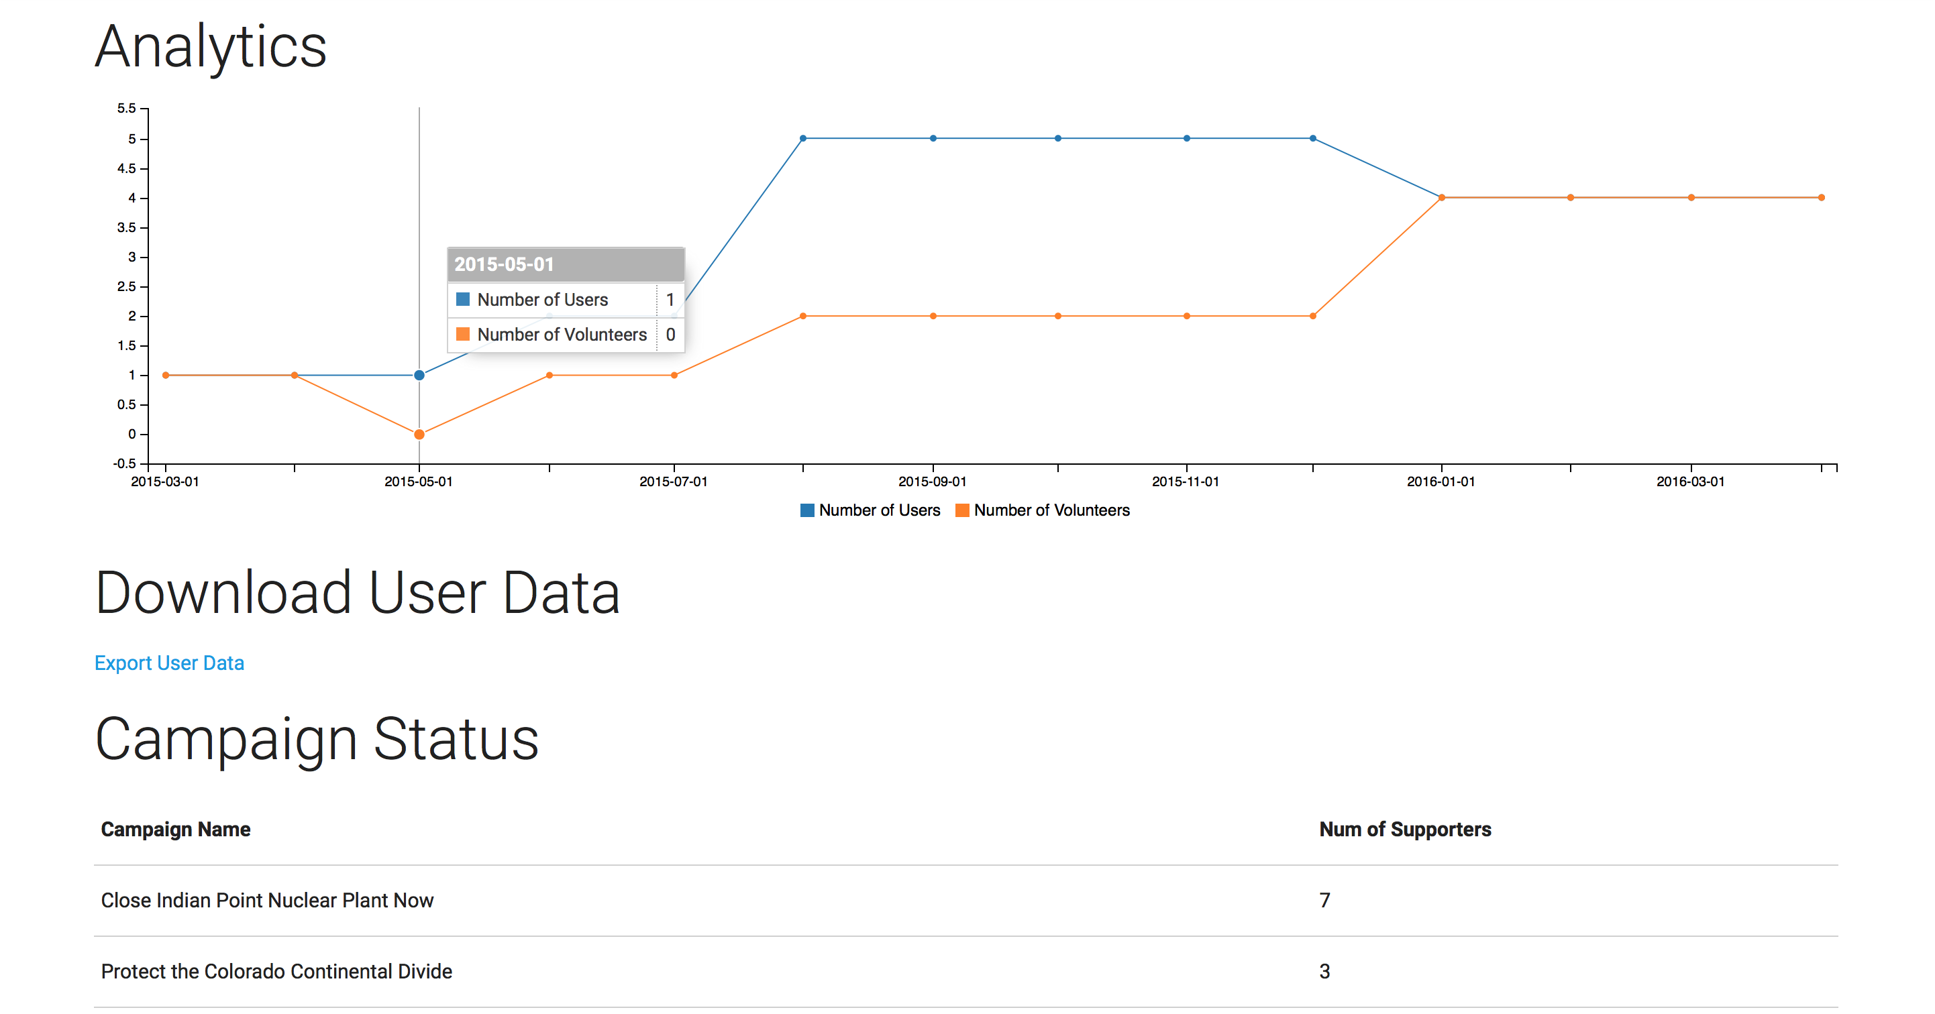
Screenshot of Website

Slide 7
Future aspirations
Update users from app offline to website.
Option to sign up on website.
Multimedia upload/integration

